Slide 1

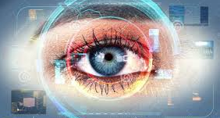
QUICK AID EYED
Capture
Analyse
Diagnosis
Reflect

Slide 2
Convolutional Neural Network
  Convolutional neural network (CNN, or ConvNet) is a class of deep, feed-forward artificial neural networks that has successfully been applied to analysing visual imagery.
  A CNN consists of an input and an output layer, as well as multiple hidden layers. The hidden layers of a CNN typically consist of convolutional layers, pooling layers, fully connected layers and normalization layers

Slide 3
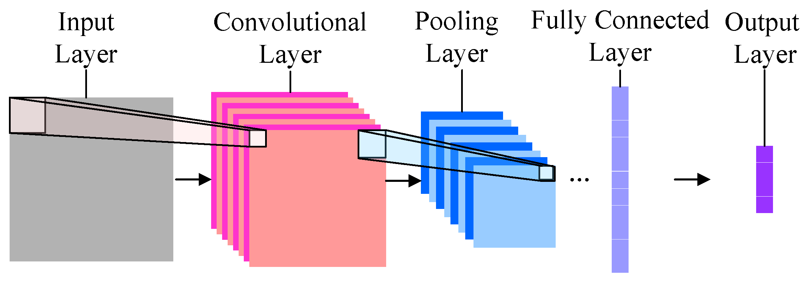
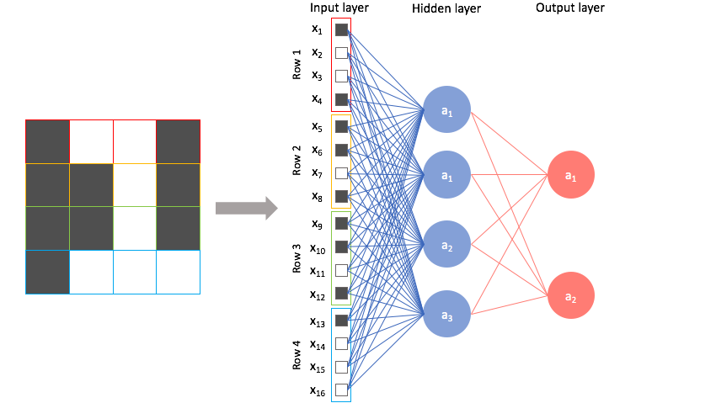
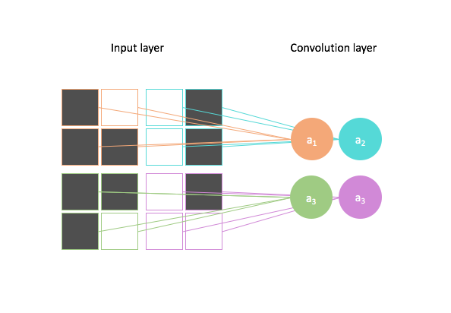

Slide 4
In computer vision, image segmentation is the process of partitioning a digital image into multiple segments
The goal of segmentation is to simplify an image into something that is more meaningful and easier to analyze.
Image segmentation is typically used to locate objects and boundaries (lines, curves, etc.) in images.
Digital image processing is the use of computer algorithms to perform image processing on digital images.

Slide 5
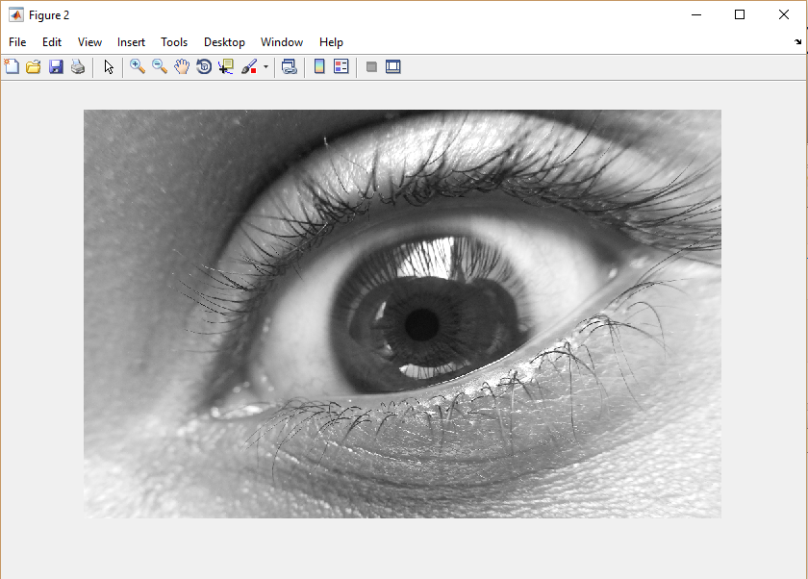
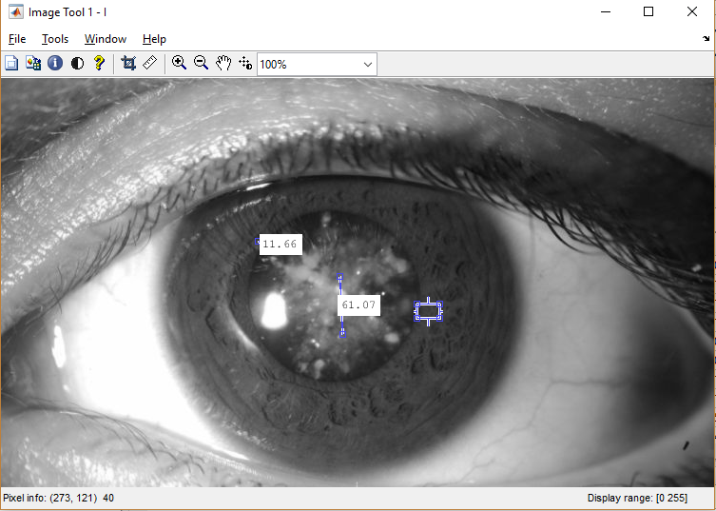
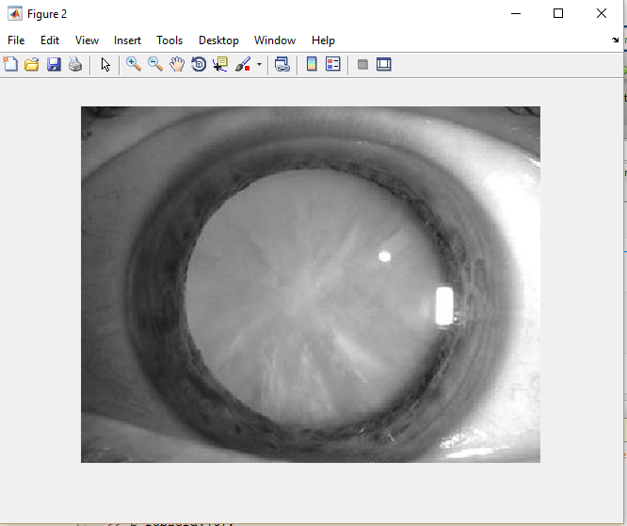

Slide 6
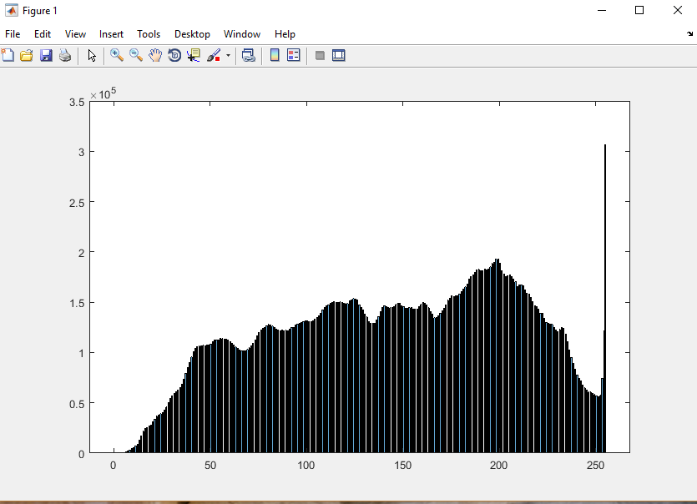
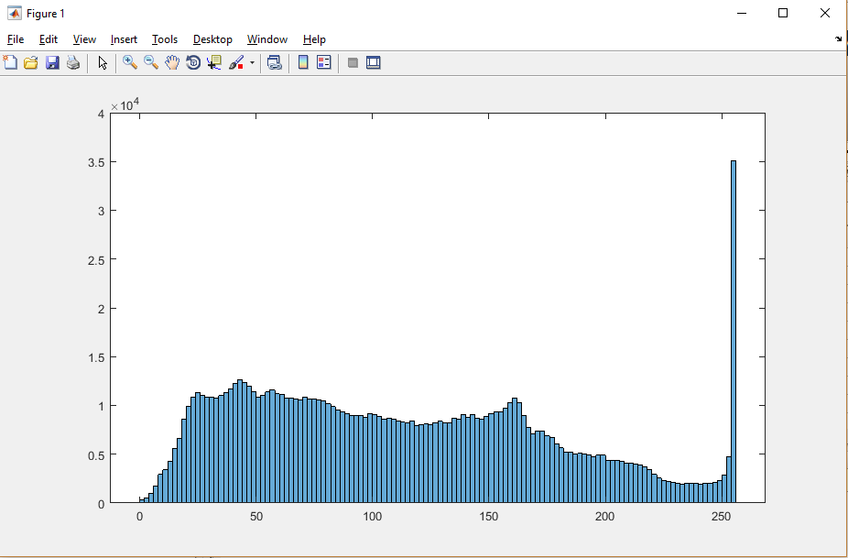
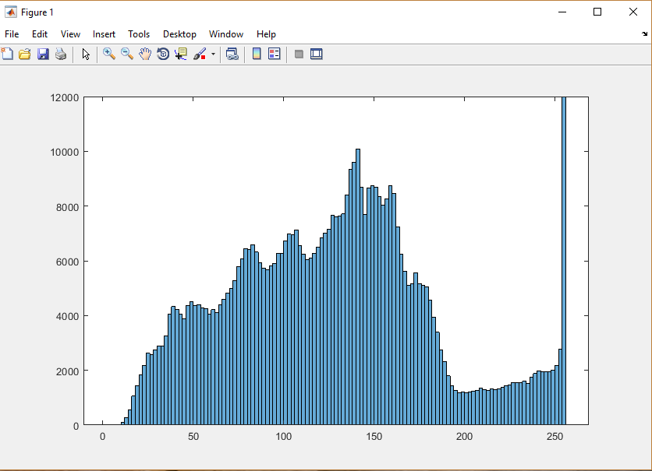

Slide 7
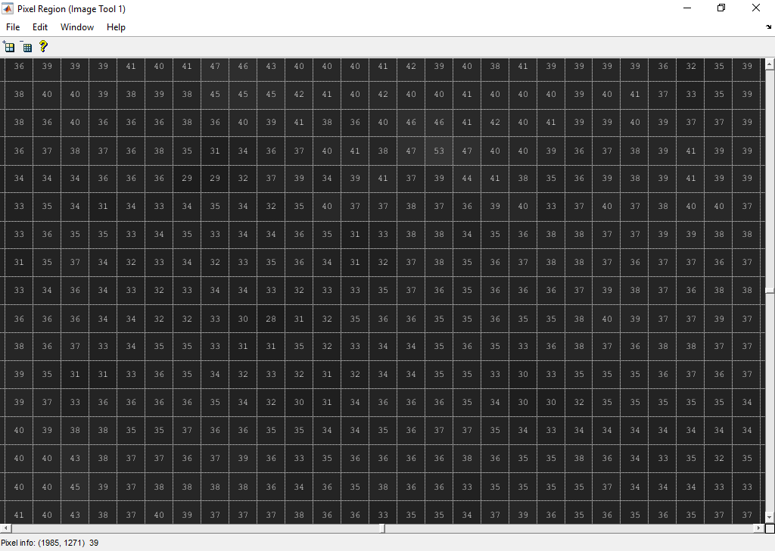
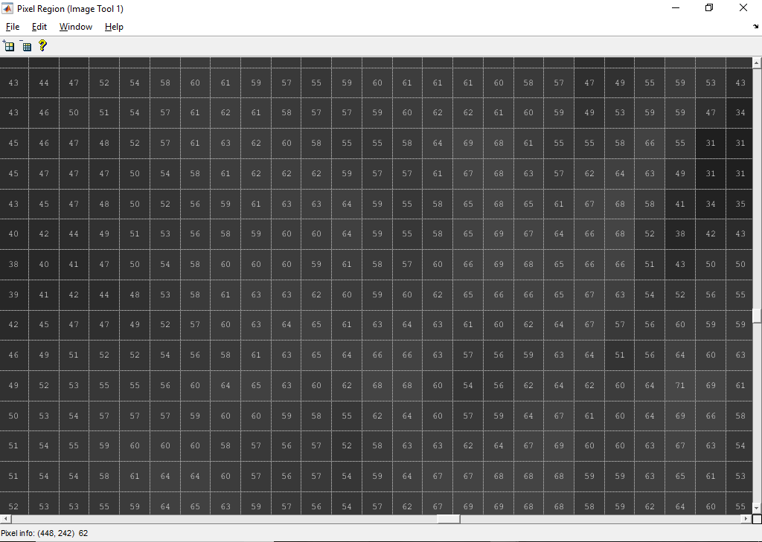
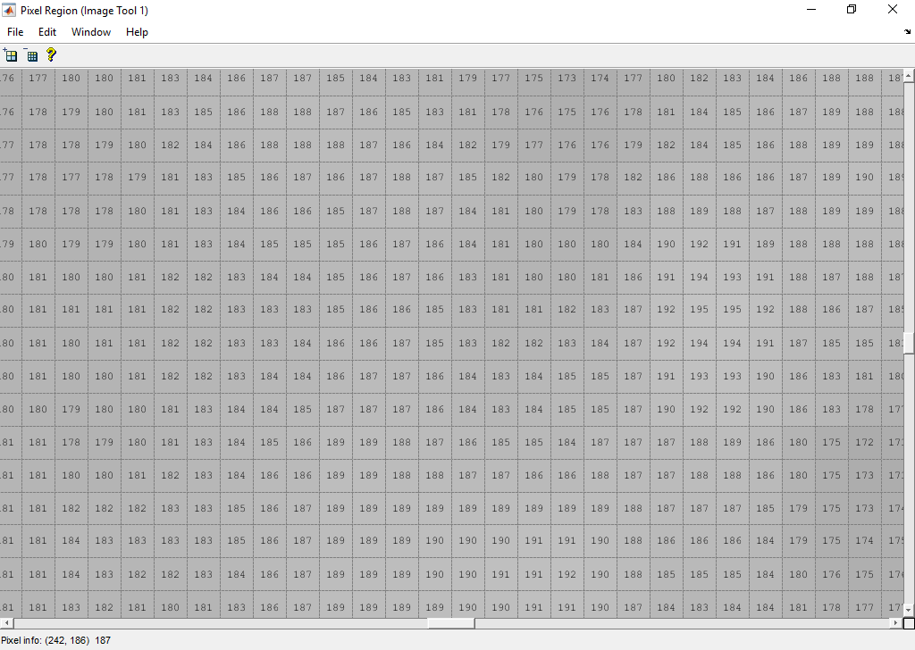

Slide 8
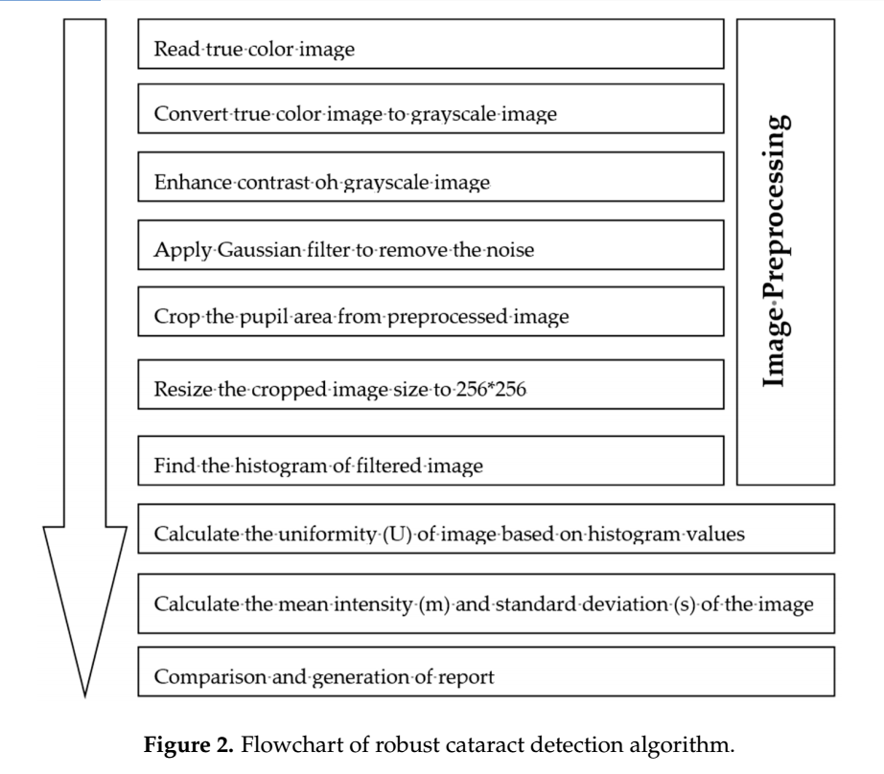
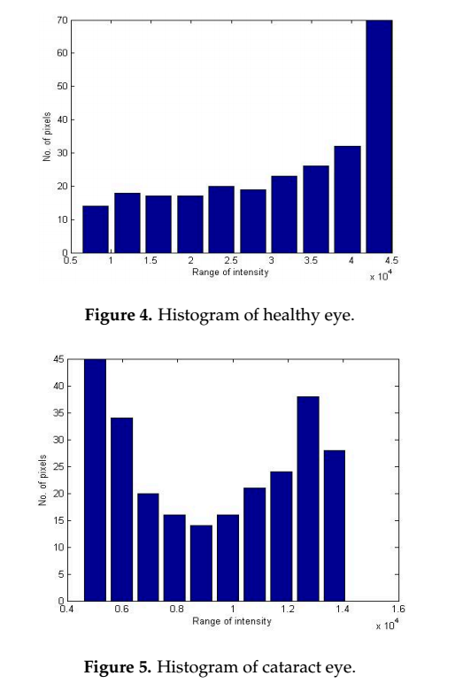

Slide 9
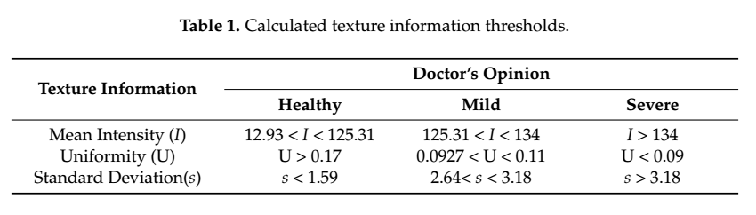
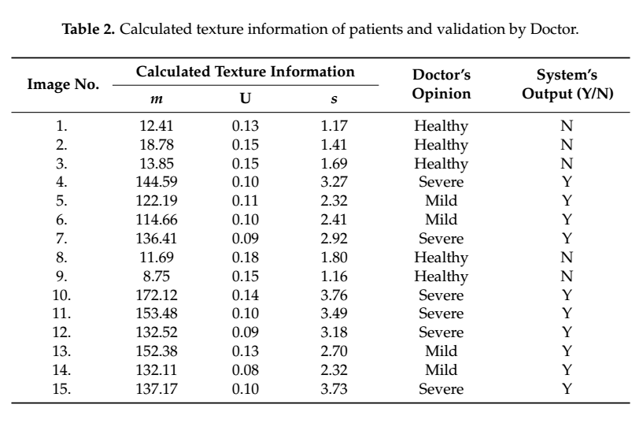
Alternate Method…

Slide 10
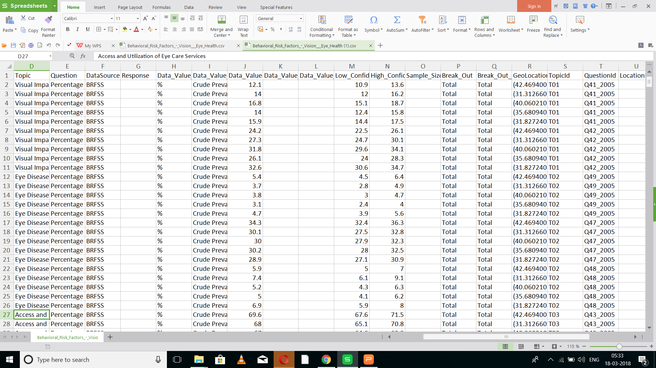

Slide 11
What is One Hot Encoding?
A one hot encoding is a representation of categorical variables as binary vectors.
This first requires that the categorical values be mapped to integer values.
Then, each integer value is represented as a binary vector that is all zero values except the index of the integer, which is marked with a 1.
Notes:
A one hot encoding is a representation of categorical variables as binary vectors.
This fi

Slide 12
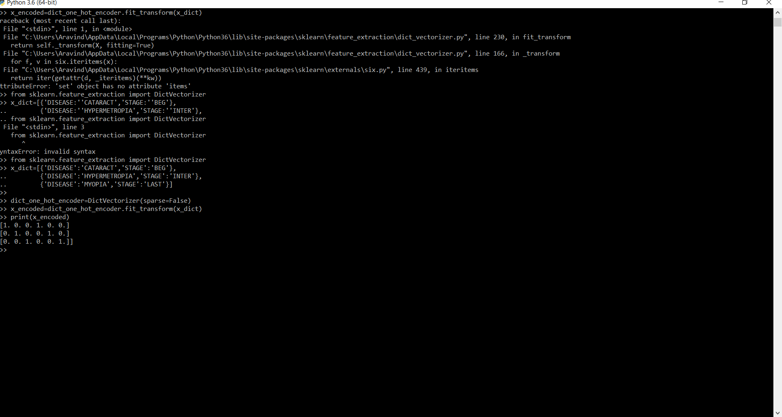

Slide 13
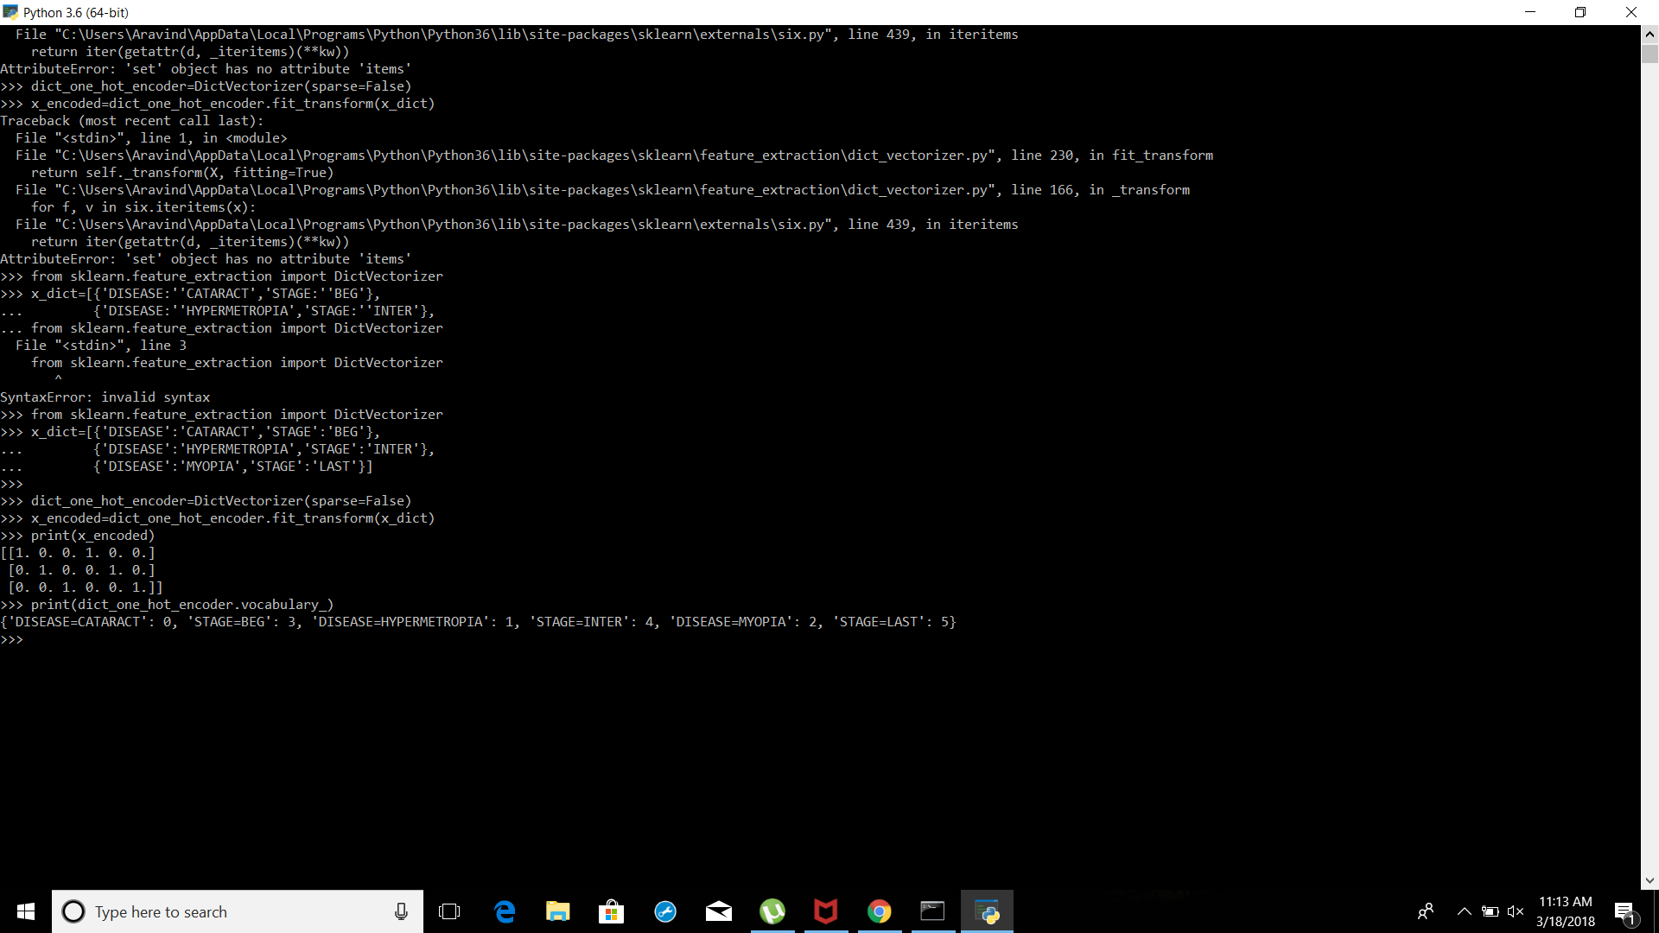

Slide 14


Slide 15
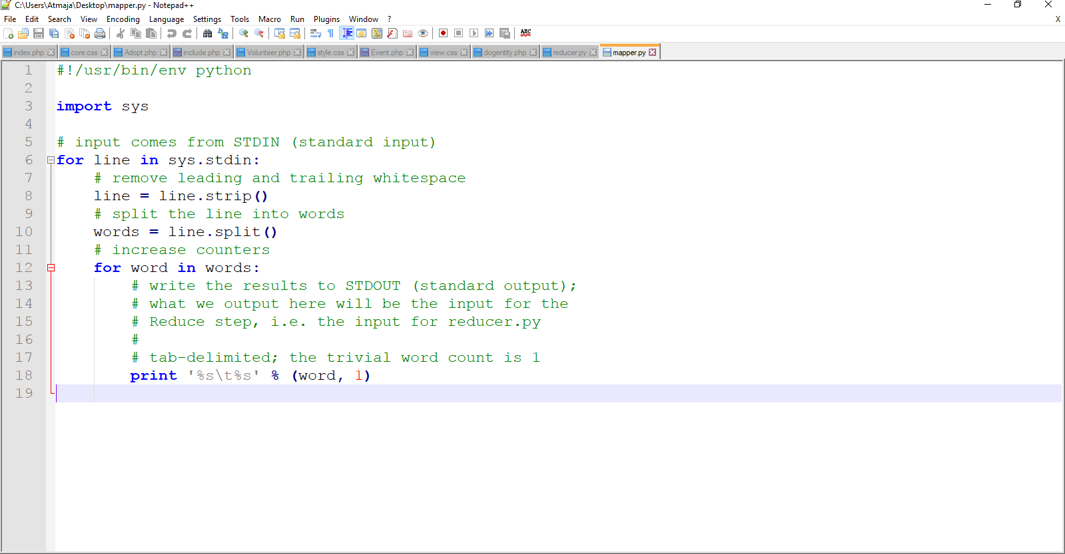
Mapper

Slide 16

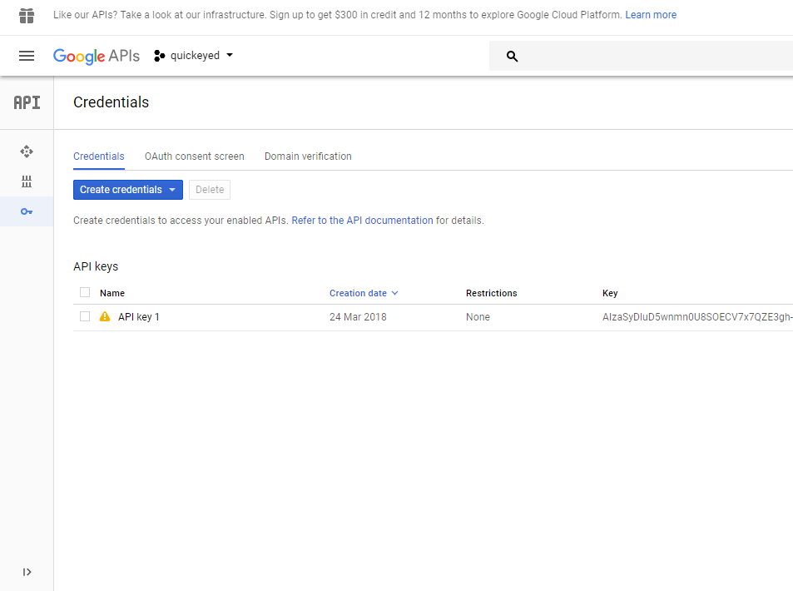
We further tried to connect with the google search engine so that we could provide information on the diagnosis
We are using the Custom Search API.

Slide 17
Machine Learning and Artificial intelligence
AI method is based on deep learning, a machine-learning algorithm .
It interprets the complex patterns and structure observed in real-life data by building multi-layer artificial neural networks, a process which shows similarities with the learning process that occurs in layers of neurons in the brain’s neocortex, the region where thinking occurs.
AI-powered systems to make diagnosis more accurate.

Slide 18
IMPACT ON HEALTH CARE
Very high precision and accuracy due to the use of AI and machine learning algorithms.
Cost effective and simple.
Accessible to everyone.
Earlier diagnosis .

